Slide 1
COMPARATIVE ANALYSIS OF SUPERVISED LEARNING ALGORITHMS FOR DIAMOND PRICE PREDICTION
IE-7275 Data Mining in Engineering (Spring 2024)
Presented by:
Sabarish Subramaniam A.V

Slide 2

Introduction
Project Objective: The main objective of this project is to compare the effectiveness of different supervised learning algorithms in predicting diamond prices based on their characteristics.
Diamonds are graded based on the 4Cs: carat weight, cut, color, and clarity. These factors determine the overall quality and value of a diamond.
Selected Algorithms: Linear Regression, K-Nearest Neighbors (KNN), Decision Tree, and Random Forest.
Overall, this project addresses the important task of predicting diamond prices accurately, which has significant implications for the diamond industry and related sectors.
Through our comparative analysis of supervised learning algorithms, we aim to provide valuable insights for stakeholders involved in diamond pricing, manufacturing, and trading.

Slide 3
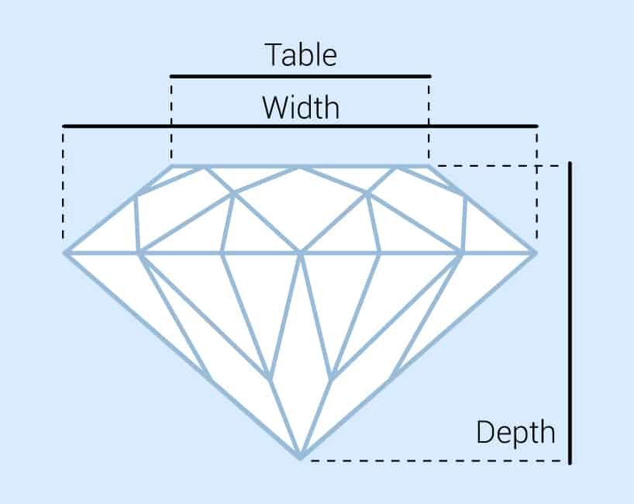
Dataset Overview:
Dataset Source: Kaggle (Link)
Comprises prices and characteristics of nearly 54,000 diamonds.
Importance: Each attribute plays a role in determining diamond prices.
Columns:
price : price in US dollars
carat : weight of the diamond
cut : quality of the cut ( Fair , Good , Very Good , Premium , Ideal )
color : diamond colour, from J ( worst ) to D ( best )
clarity : a measurement of how clear the diamond is ( I1 (worst) ,SI2 ,SI1 ,VS2 ,VS1 ,VVS2 ,VVS1 ,IF (best))
x : length in mm
y : width in mm
z : depth in mm
depth : total depth percentage = z / mean( x, y ) = 2 * z / ( x + y )
table : width of top of diamond relative to widest point

Slide 4
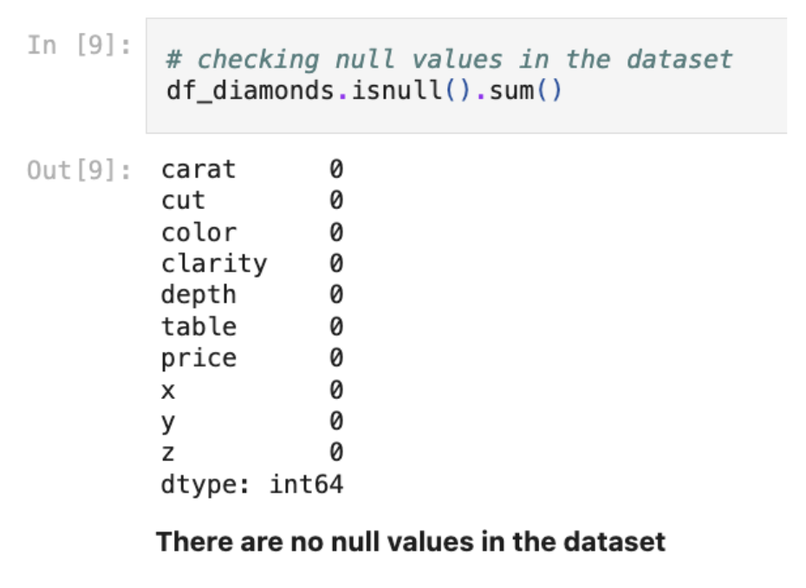
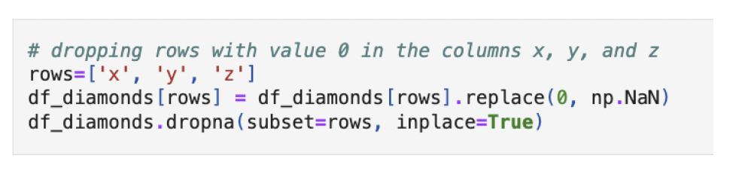
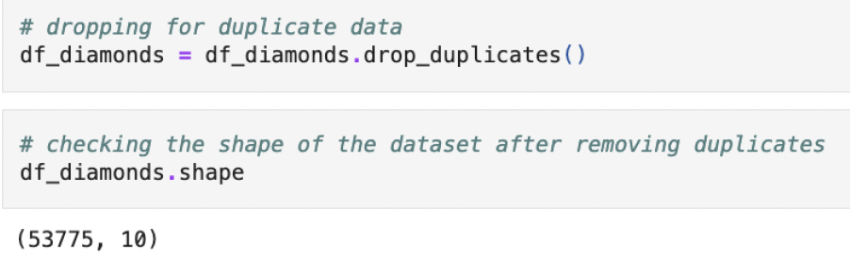
Dataset Preprocessing
Data Cleaning: Handling null values, filtering faulty data, removing duplicates.
1. Checking for null values 2. Filtering Faulty Data
3. Removing duplicates

Slide 5
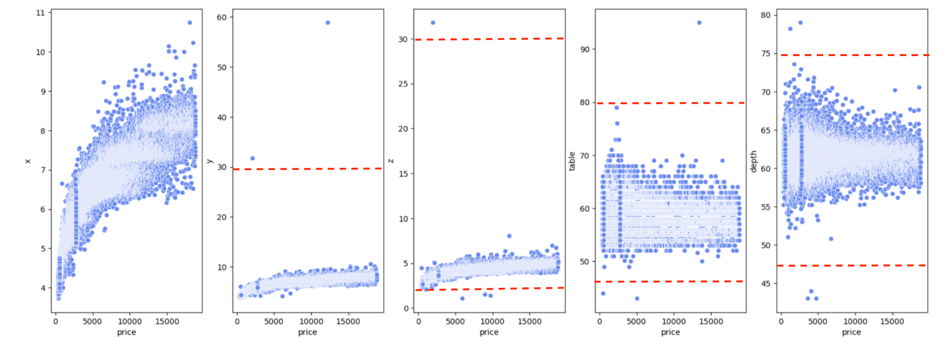
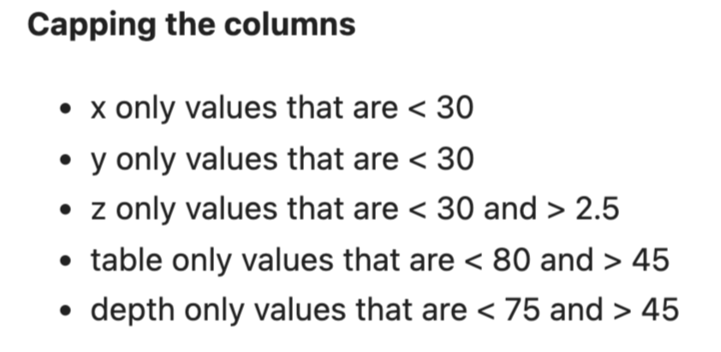
4. Analyzing Outliers

Slide 6
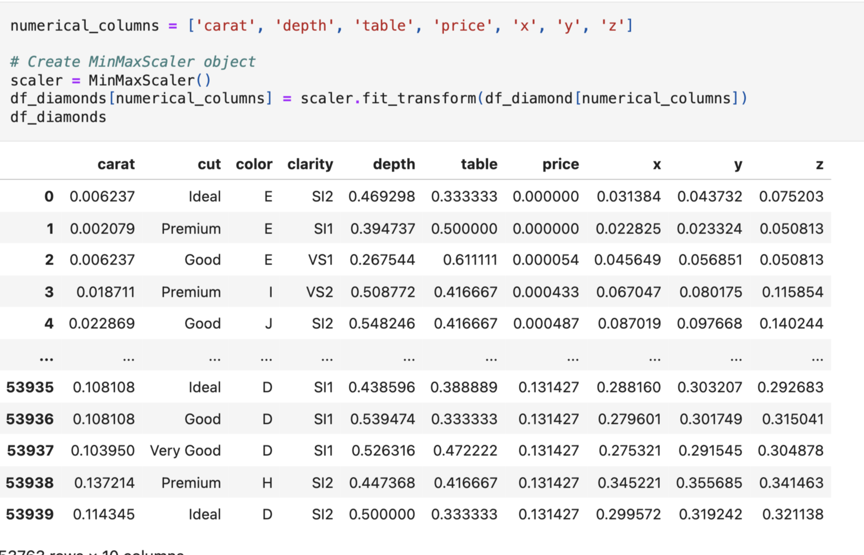
5. Normalization
To ensure uniformity and facilitate model convergence, the dataset is normalized using the MinMaxScaler() function. This step scales numerical features to a range between 0 and 1, preserving the relative differences between data points while standardizing their magnitudes
This uniformity avoids the domination of features that have larger values compared to the other features or variables.

Slide 7
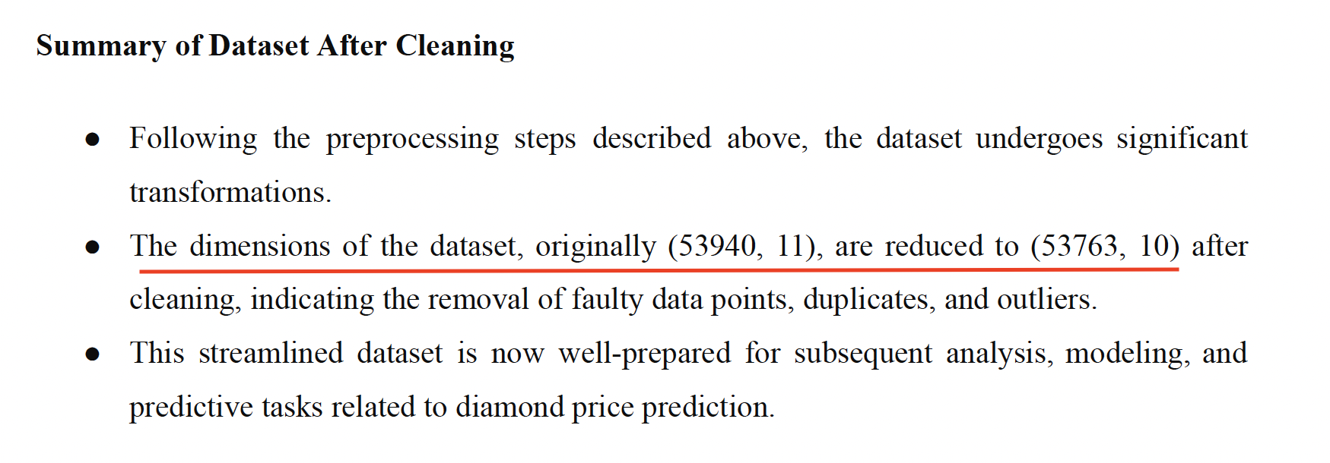

Slide 8
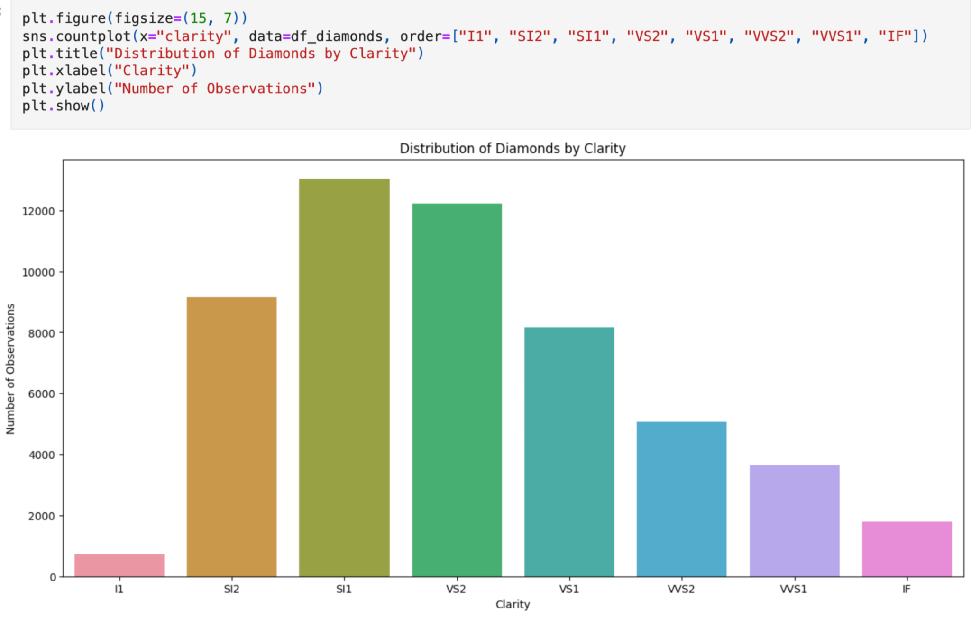
EXPLORATORY DATA ANALYSIS (EDA) AND FEATURE SELECTION
Distribution: Visualize diamond distribution by clarity.

Slide 9
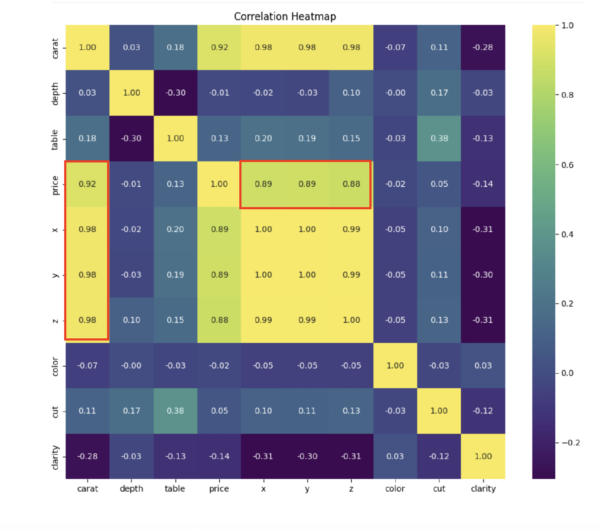
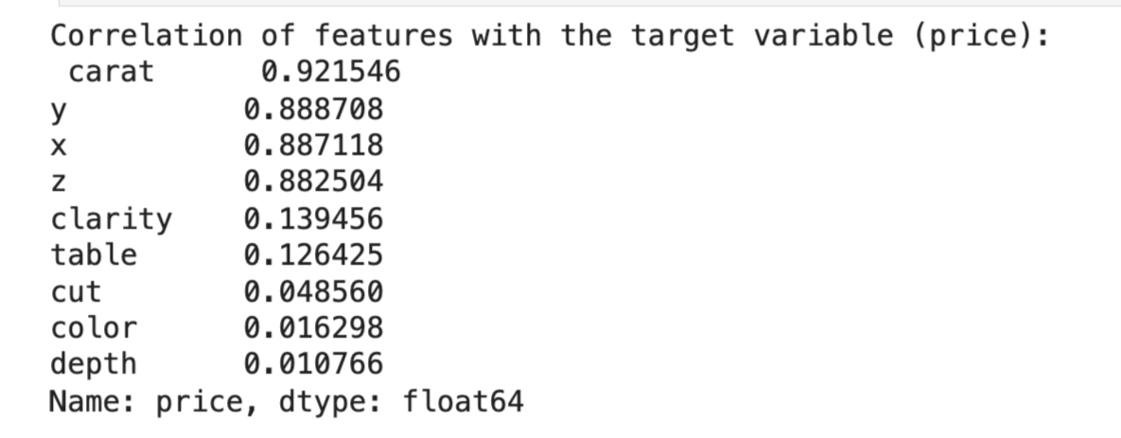
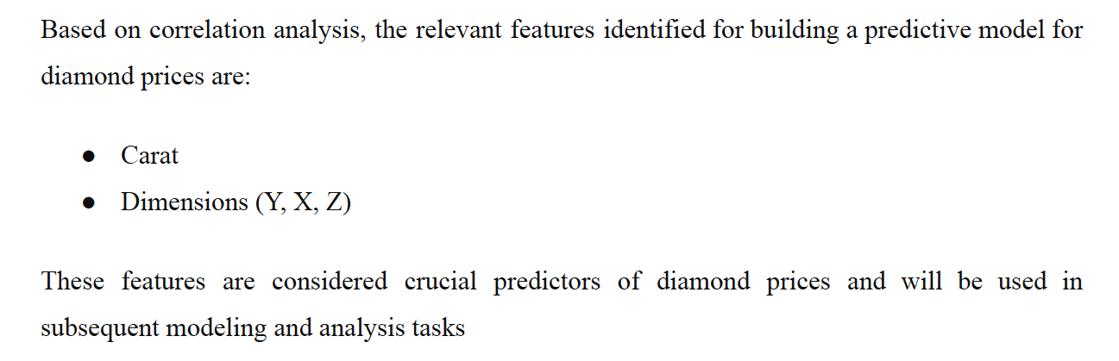
Identifying Important features
Correlation Heatmap: Identify important features for modeling.
Feature Selection: Highlight significant predictors for diamond prices.

Slide 10
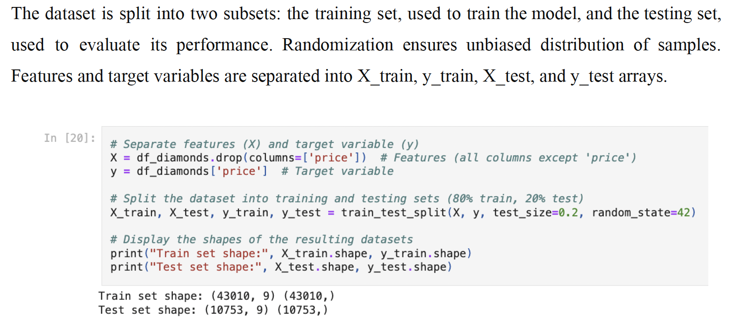
MODEL IMPLEMENTATION AND BASELINE EVALUATION
Splitting the data into training and testing datasets:

Slide 11
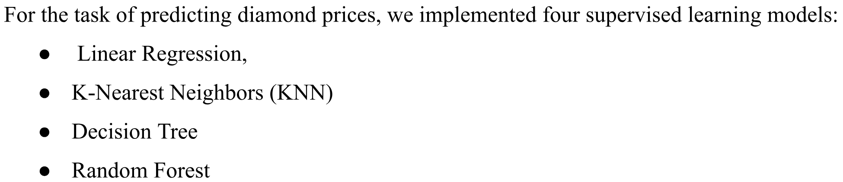
Linear Regression: Basic regression assuming linear relationship between features and target variable.
KNN: Non-parametric algorithm making predictions based on similarity to nearest neighbors.
Decision Tree: Recursive partitioning of feature space to make decisions at each node.
Random Forest: Ensemble learning technique combining multiple decision trees for improved performance.

Slide 12
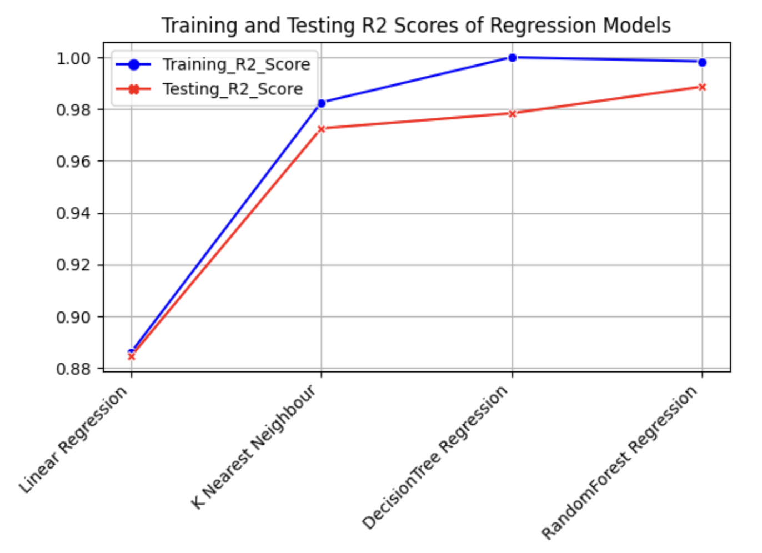
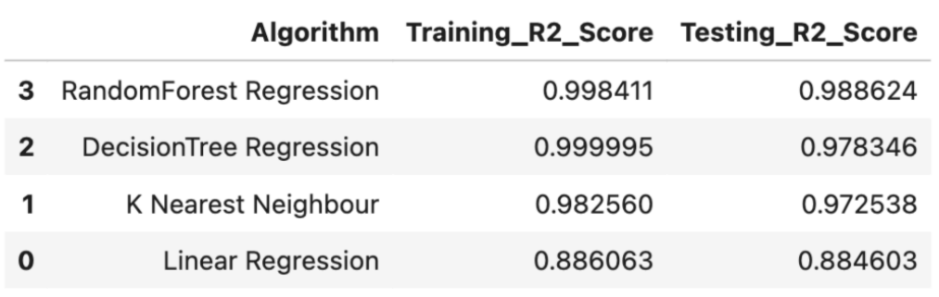
Baseline Evaluation
The Random Forest Regression model exhibits high performance on both the training and testing sets, with R2 scores close to 1.
This indicates that the model captures a significant portion of the variance in the target variable and generalizes well to unseen data.

Slide 13
Hyperparameter Tuning using Random Search
Hyperparameter tuning is a crucial step in optimizing the performance of machine learning models. It involves adjusting the hyperparameters, which are parameters that are not directly learned during training but rather set prior to training.
These hyperparameters control the learning process and the complexity of the model, ultimately affecting its predictive accuracy and generalization ability.
Random Search is a popular technique for hyperparameter tuning. Unlike grid search, which evaluates all possible combinations of hyperparameters, random search selects a random subset of hyperparameter combinations to evaluate.
This approach is computationally efficient and often yields satisfactory results, especially for high-dimensional or complex search spaces.
Computational Efficiency: Random search explores the hyperparameter space more efficiently compared to grid search, as it evaluates fewer combinations.

Slide 14
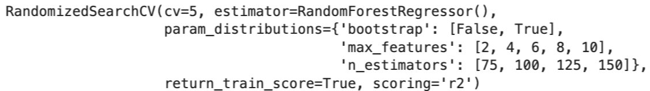
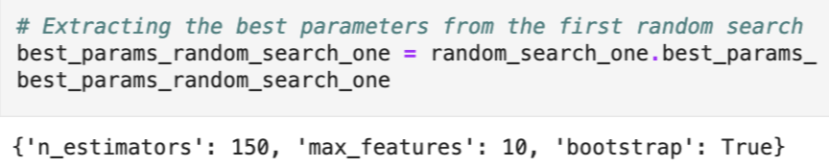
n_estimators: number of trees in the forest
max_features: maximum number of features considered for splitting a node.
Using Random Search, we explored different combinations of these hyperparameters and evaluated their performance using metrics such as RMSE (Root Mean Squared Error) and R2 score on a validation dataset.
The optimal hyperparameters found through random search were {'n_estimators': 150, 'max_features': 10, 'bootstrap': True}.
R2 value of the Random Forest Regressor after Hyperparameter Tuning: 0.9887

Slide 15
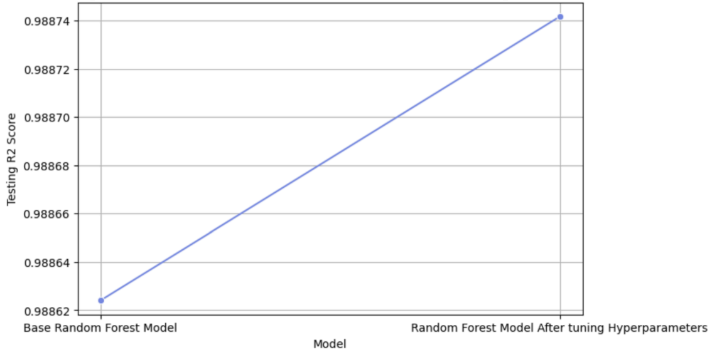
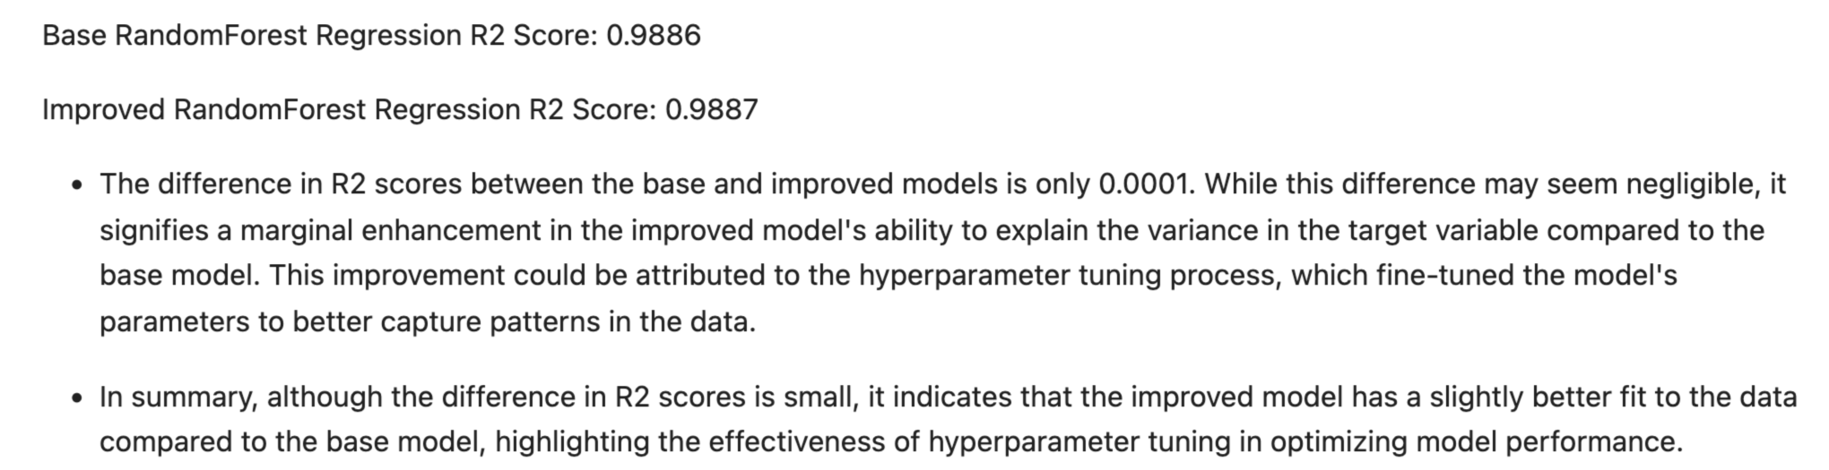

Slide 16
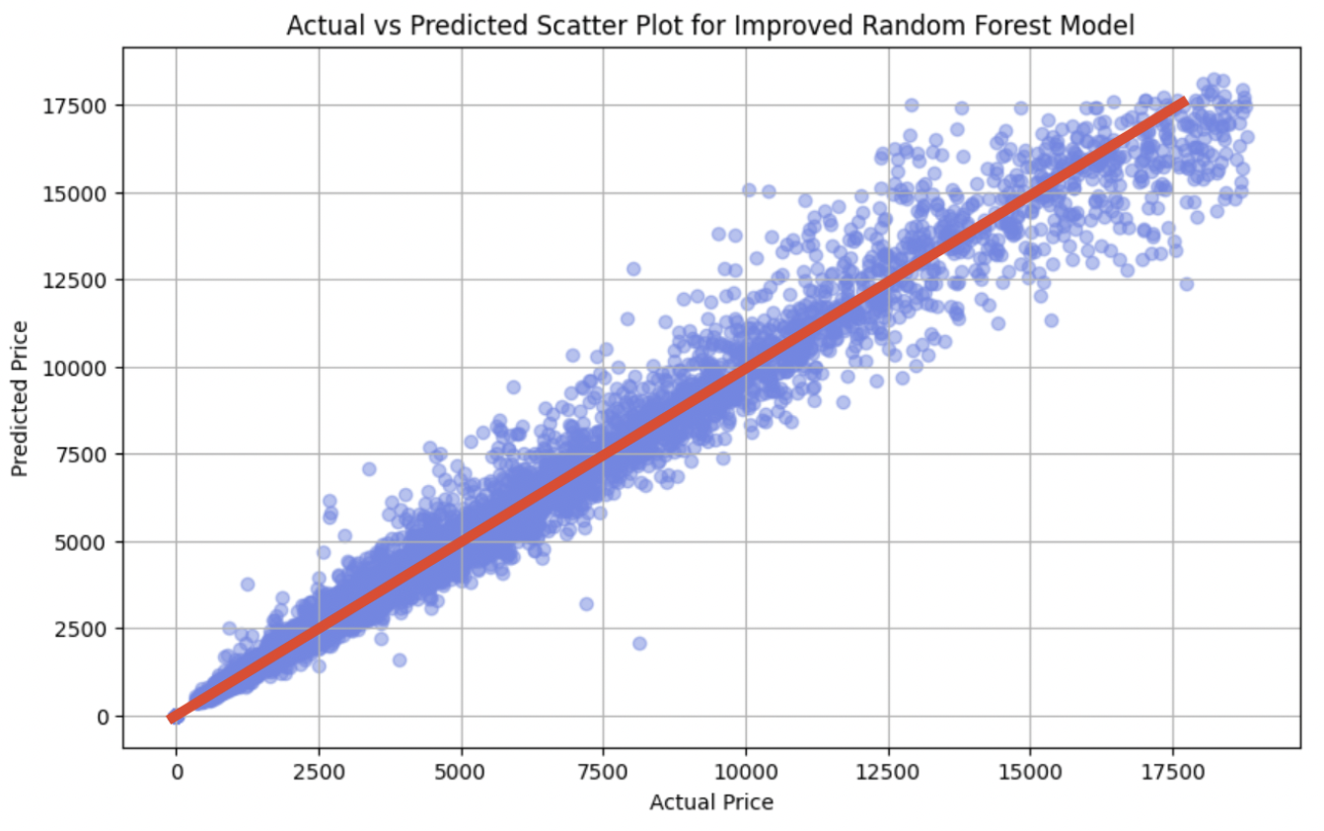
MODEL EVALUATION AND COMPARATIVE ANALYSIS
Upon examining the scatter plot, it becomes evident that the majority of the data points align closely along a diagonal line.
This alignment indicates a strong positive correlation between the actual and predicted diamond prices. Specifically, as the actual diamond prices increase, the predicted prices by the Random Forest model also increase proportionally
Overall, the scatter plot serves as a powerful visualization tool to assess the performance of the Random Forest model for predicting diamond prices.
The close alignment of data points along the diagonal line signifies the model's ability to capture the underlying relationships in the dataset and make accurate predictions.

Slide 17
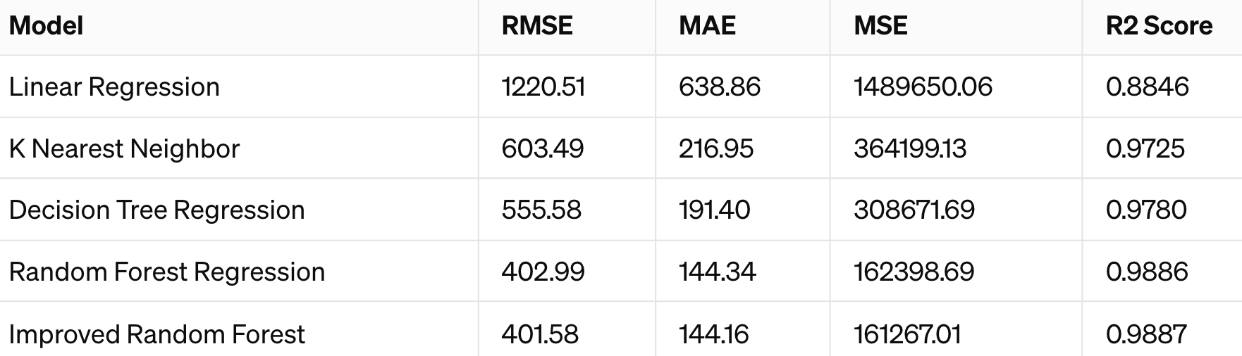
Comparison of Regression Models Based on Performance Metrics

Slide 18
Conclusion
Improved Random Forest Model:
The improved Random Forest model shows even better performance on the testing data compared to the regular Random Forest model, with slightly lower RMSE and slightly higher R2 Score.
This indicates that hyperparameter tuning or other optimization techniques have led to a better-performing model.
Overall, all models perform well on the testing data, but the Random Forest model after hyperparameter tuning appears to be the best-performing model for predicting diamond prices

Slide 19
REFERENCES
● Assessing predictive performance of supervised machine learning algorithms. (IEEE - ISBN:978-1-6654-3034-0)
● Size distribution analyses for estimating diamond grade and value. (Lithos - Volume 76, Issues 1–4, September 2004)
● Comparing different supervised machine learning algorithms.
(BMC Medical Informatics and Decision Making - Volume 19, Article number 281, 2019)

Slide 20
THANK YOU

